Slide 1

Unit 2: Data Preprocessing using Python
DSA0405 – FUNDAMENTALS OF DATA SCIENCE
Guided by
Dr. M. Krishnaraj
Name: Jothika M Register Number: 192324235 Department: B . Tech (AI & DS) Batch: 2023–2027

Slide 2


Introduction to Data Preprocessing
What is Data Preprocessing?
Data preprocessing is the process of cleaning, organizing, and transforming raw data into a useful format before analysis.
Why is it Important?
Improves data quality
Removes errors and duplicates
Handles missing values
Converts raw data into meaningful information
Improves model accuracy
Main Steps
Reading Data
Selecting Data
Filtering Missing Values
Sorting
Grouping
Ranking
Data Visualization

Slide 3

Data Manipulation
What is Data Manipulation?
Data manipulation means modifying data into a useful format.
Operations
• Reading Data
• Selecting Data
• Filtering Data
• Sorting
• Grouping
• Ranking
• Plotting
Example
Student Dataset
Name | Marks
John | 82
Mary | 91
David | 76

Slide 4
Reading Data
Reading data means importing data from files, databases, or online sources into Python.
The Pandas library is commonly used.
Supported File Formats
CSV
Excel
JSON
SQL Database
Text Files
Python Functions
import pandas as pd
df = pd.read_csv("students.csv")
Read Excel file
df = pd.read_excel("students.xlsx")

Slide 5
Other Reading Functions
Function | Purpose
read_csv() | Read CSV File
read_excel() | Read Excel File
read_table() | Read Tabular File
read_json() | Read JSON File
read_sql() | Read Database
read_clipboard() | Read Clipboard Data

Slide 6
Viewing and Exploring Data
Once the dataset is imported, we examine its contents.
head()
Displays the first 5 rows.
edu.head()
Example
tail()
Displays the last 5 rows.
edu.tail()
Name | Marks
Mary | 500
John | 600
Dani | 400
Joe | 800
Pari | 1000

Slide 7
info()
Number of rows
Number of columns
Data types
Missing values
Code:
edu.info()
describe()
Provides statistical summary of numerical columns.
Code:
edu.describe()
It returns
Count
Mean
Standard Deviation
Minimum
Maximum
25%
50%
75%

Slide 8
Data Selection
Selection means extracting only the required rows or columns from a dataset.
Selecting Columns
df["Name"]
Multiple Columns
df[["Name","Marks"]]
Selecting Rows
df.iloc[0]
Using Labels
df.loc[2]
Conditional Selection
Students scoring above 80
df[df["Marks"]>80]
Benefits
Reduces unnecessary data
Faster analysis
Easy data exploration

Slide 9
Filtering Missing Data Missing Data Missing values occur when information is unavailable.
Check Missing Values
edu.isnull()
Count Missing Values
edu.isnull().sum()
Remove Missing Values
edu.dropna()
Removes rows containing missing values.
Fill Missing Values
Using Zero
edu.fillna(0)
Using Mean
edu["VALUE"].fillna(edu["VALUE"].mean())

Slide 10
Sorting Data
Sorting arranges records in ascending or descending order.
Ascending
edu.sort_values("VALUE")
Descending
edu.sort_values("VALUE",ascending=False)
Multiple Columns
edu.sort_values(["TIME","VALUE"])
Applications
Student Marks
Employee Salary
Product Price
Sales Report

Slide 11
Grouping Data
Grouping combines similar records together.
Function
groupby()
Example
edu.groupby("GEO")["VALUE"].mean()
Output
Aggregation Functions
mean()
sum()
min()
max()
count()
Country | Average Value
India | 5.4
Canada | 6.2
USA | 5.9
Example
edu.groupby("GEO").sum()

Slide 12
Ranking Data
Ranking assigns an order to values.
Example
edu["Rank"] = edu["VALUE"].rank()
Highest Rank
edu["Rank"] = edu["VALUE"].rank(ascending=False)
Output
Name | Marks | Rank
Pari | 1000 | 1
Joe | 800 | 2
John | 600 | 3

Slide 13
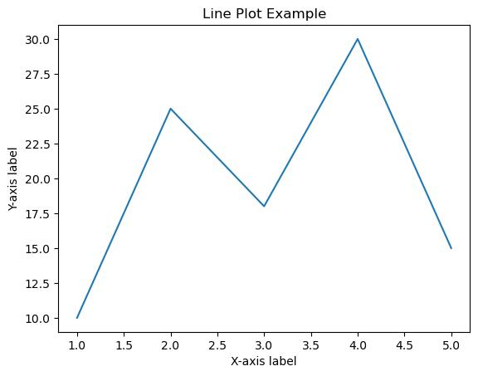
Plotting Data
Plotting converts numerical data into visual graphs.
Library
import matplotlib.pyplot as plt
Line Graph
plt.plot(edu["VALUE"])
plt.show()
Shows trends over time.

Slide 14
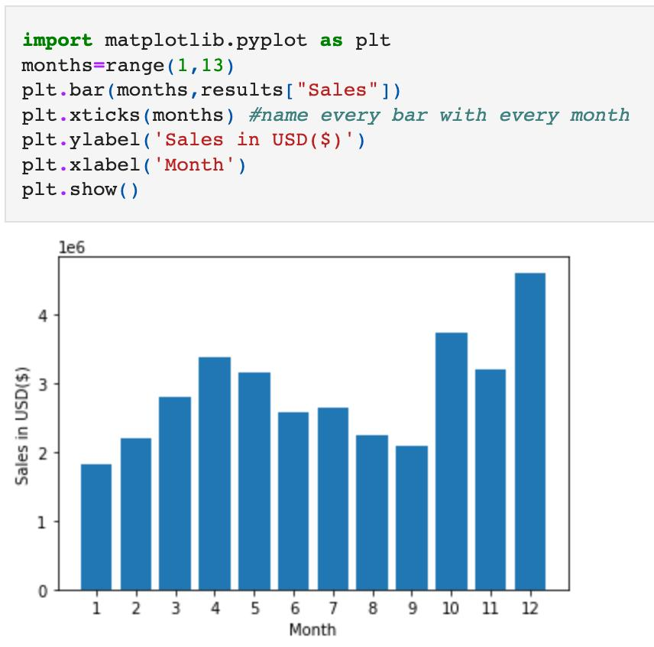
Bar Chart
plt.bar(edu["TIME"],edu["VALUE"])
plt.show()
Compares categories.

Slide 15
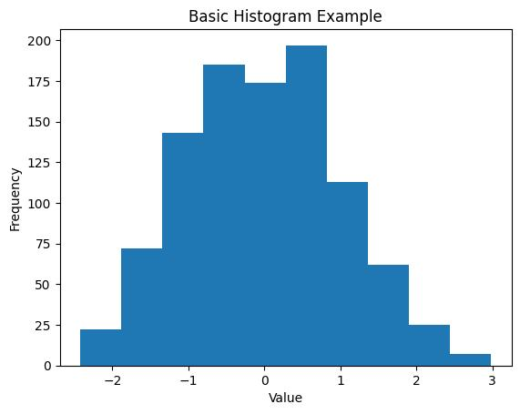
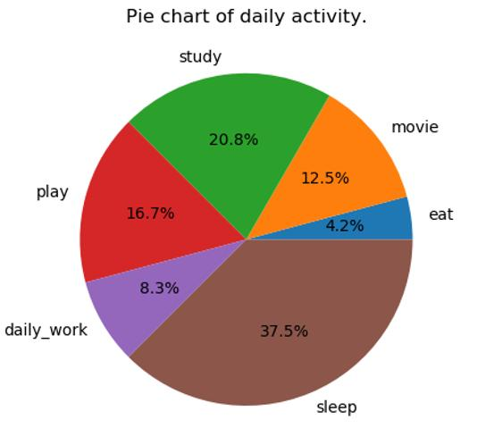
Histogram
plt.hist(edu["VALUE"])
plt.show()
Shows frequency distribution.
Pie Chart
plt.pie(edu["VALUE"],labels=edu["TIME"])
plt.show()

Slide 16
Real-Time Applications
Healthcare - Patient Records
Banking- Transaction Analysis
E-commerce - Product Sales
Education - Student Performance
Finance - Stock Market Analysis
Government - Census Analysis
Conclusion
Data manipulation is the foundation of Data Science.
Pandas provides powerful tools for reading, cleaning, selecting, sorting, grouping, ranking, and plotting data.
Proper preprocessing improves data quality and enables accurate analysis and machine learning.
Every Data Science project begins with data manipulation before model building.

